Slide 1
Euromart stores
MAJOR PROJECT 1

Slide 2

CERTISURED

Slide 3
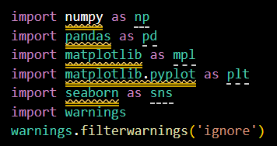
➢ IMPORTING THE NECESSARY LIBRARIES
💠 THIS PROCESS
WILL IMPORT ALL THE NECESSARY LIBRARIES TO ANALYSE THE DATA
💠CODE ⤵
NUMPY
PANDAS
MATHEMATICAL PLOTTING LIBRARY
SEABORN & etc…

Slide 4
➢ USE OF PARTICULAR LIBRARY
➫ numpy as np , Is known as numerical python this is used for numerical solving purpose
and np is its alias
➫ pandas as pd, Used for analysing the data in a table format
and pd is its alias
➫ matplotlib as mpl, Used for setting the style for data visualization
and mpl is its alias
➫ matplotlib.pyplot as plt, Used for visualizing the cleaned data
and plt is its alias
➫ seaborn as sns, Used for visualizing the data and seaborn is much updated then matplotlib
and sns is its alias
➫ warnings, Used to avoid the pop up of unnecessary warnings
THERE ARE LOTS OF LIBRARIES LIKE THIS CURRENTLY WE ARE USING FEW OF THEM

Slide 5
➢ CONNECTING THE DATA TO MYSQL
To Connecting the data to mysql we must have to import the library called
Mysql.connector
💠CODE ⤵
import mysql.connector

Slide 6
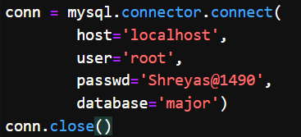
➢ CONNECTING PROCESS
💠 For first we must have to create a database in mysql
💠CODE ⤵
create database major
💠 Now we must use the below code as connection in the jupyter cell
💠CODE ⤵

Slide 7
NOW WE HAVE TO DUMP THE DATA TO
MY SQL
For dumping the data to mysql we must have to save the excel format file to csv format
Because in mysql it doesn't support the excel format files

Slide 8
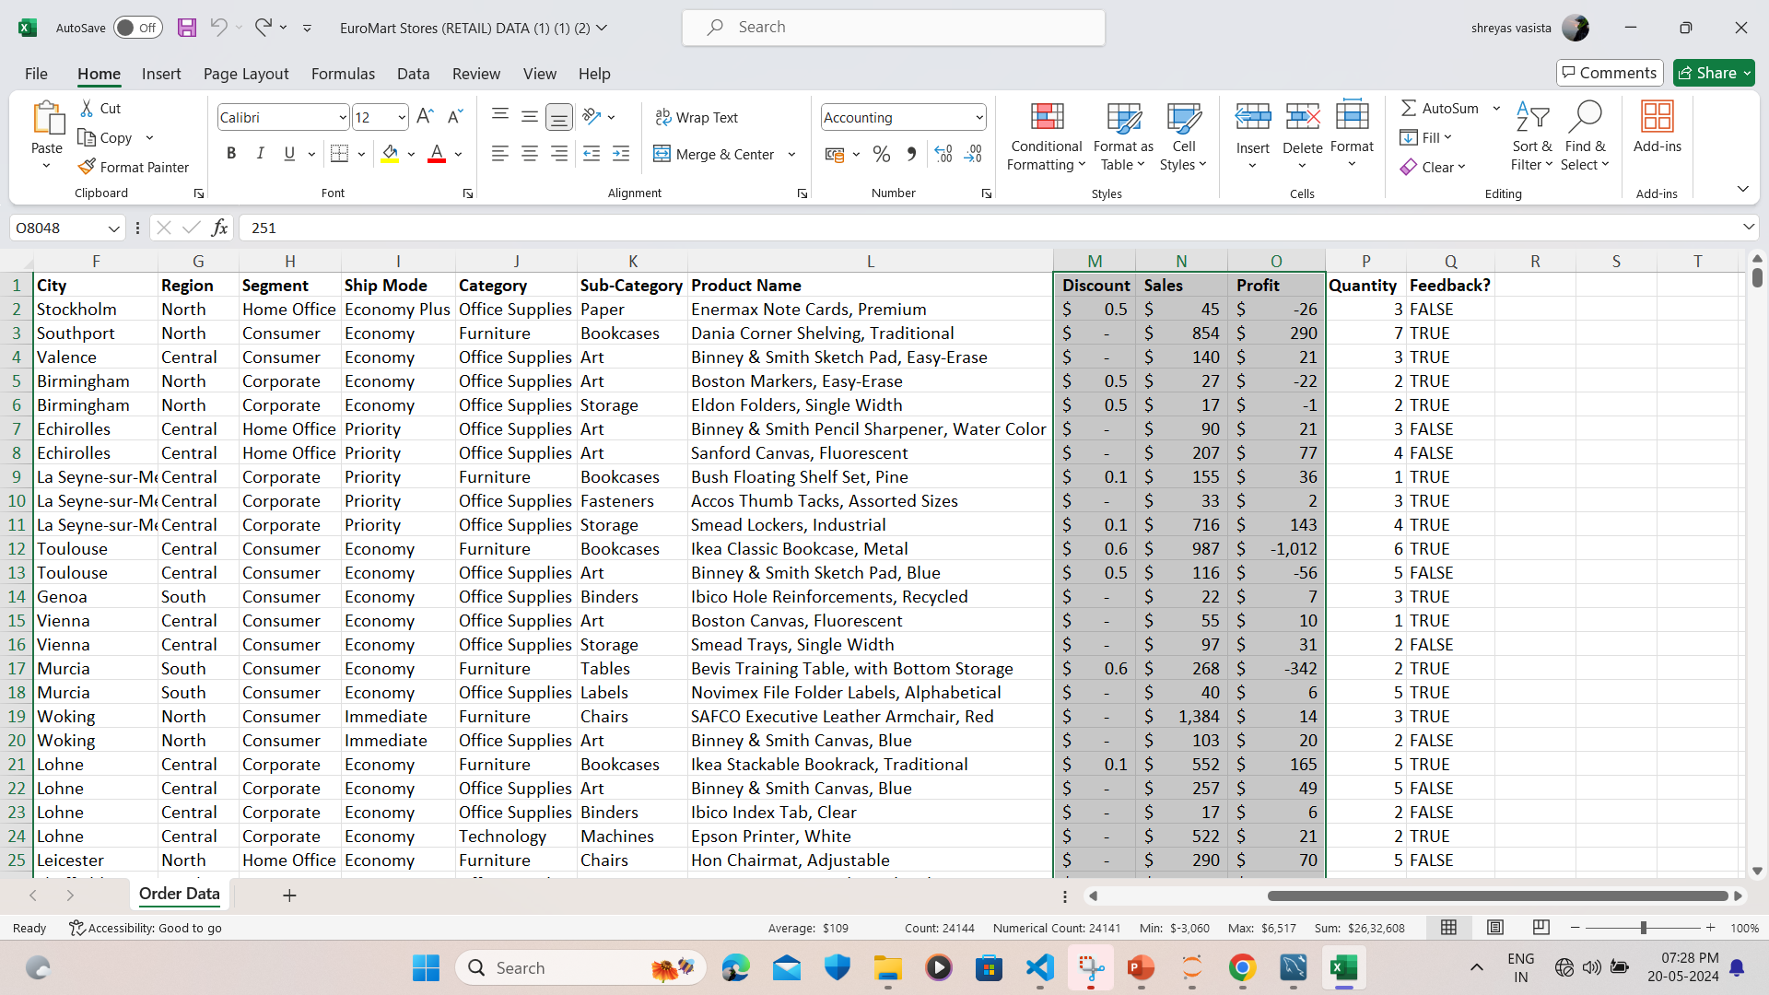
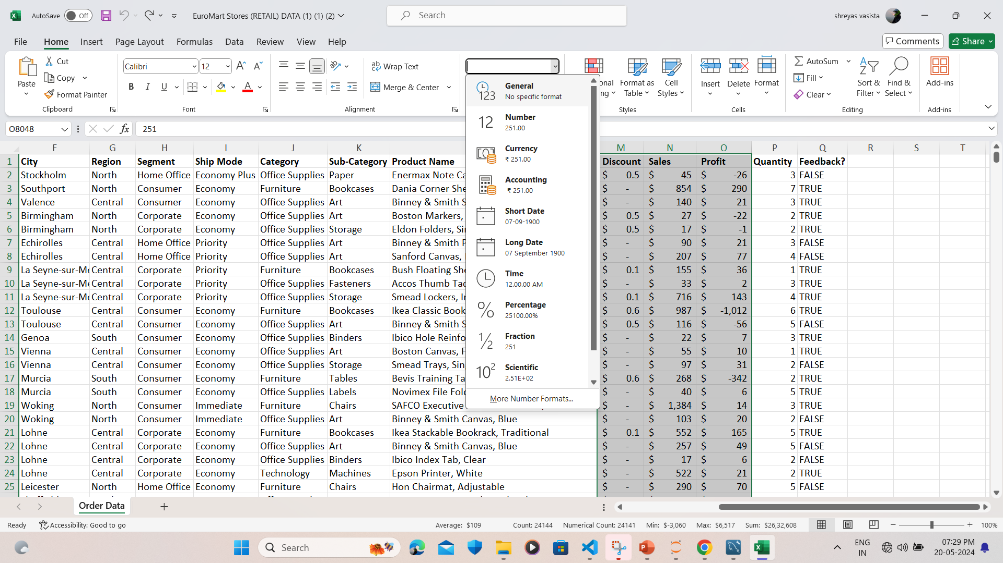
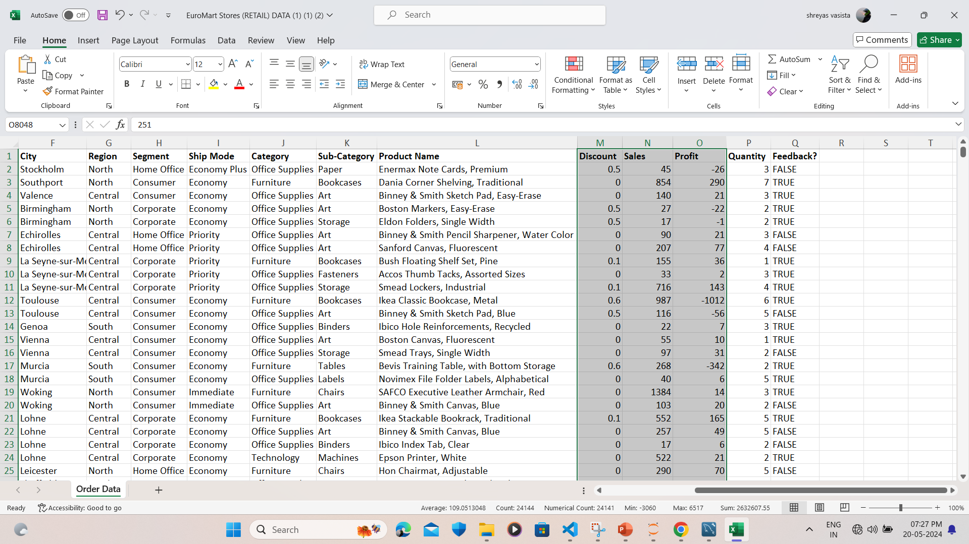
➢ CONVERTING THE DATA TYPES IN EXCEL
➦
➦

Slide 9
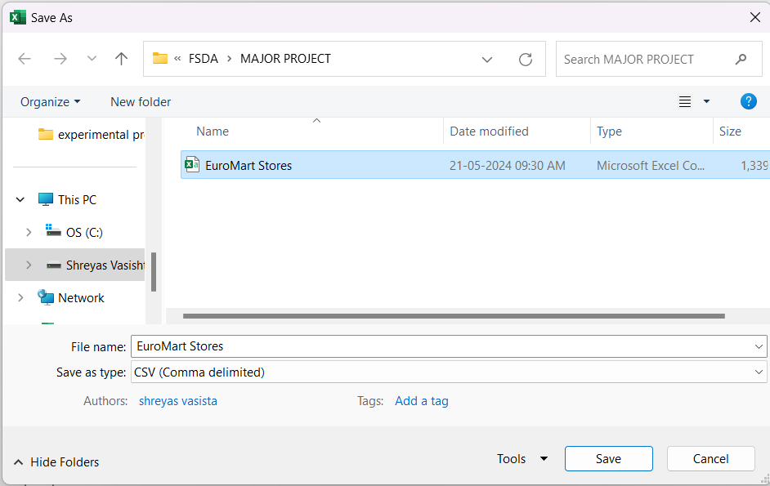
💠 Save the excel file as “COMMA SEPERATED VALUES”
💠FORMAT
➦

Slide 10
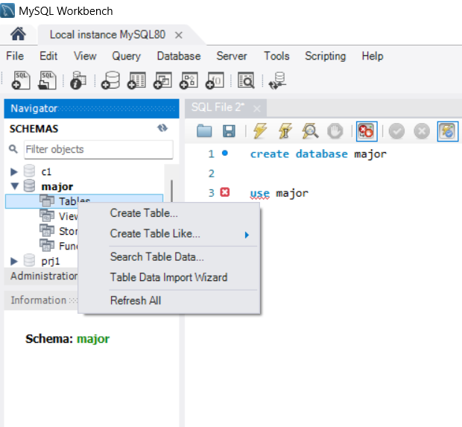
➢ IMPORTING THE DATA PROCESS
💠 we have to select which data base has to be used
💠 In navigator we have to refresh and right click on tables
💠 To import the table to sql we have to select
TABLE DATA IMPORT WIZARD
💠FORMAT
➦
MY SQL

Slide 11
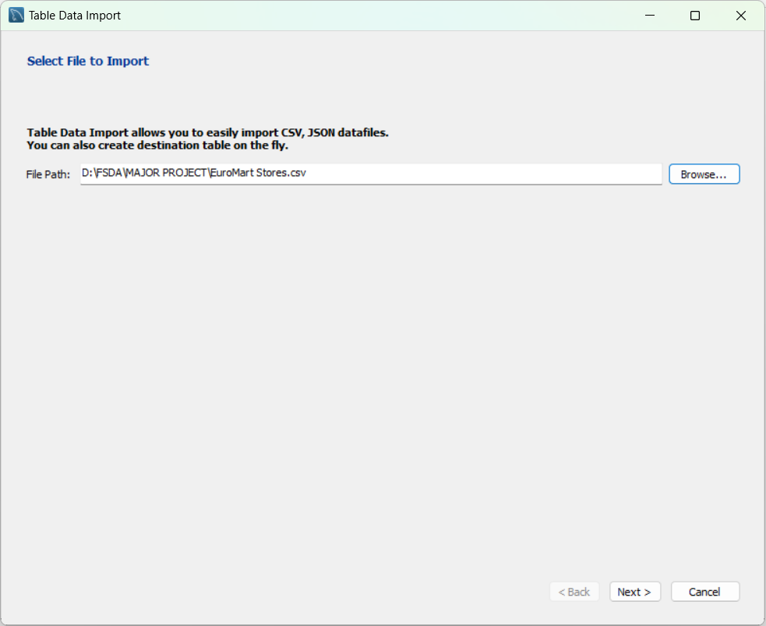
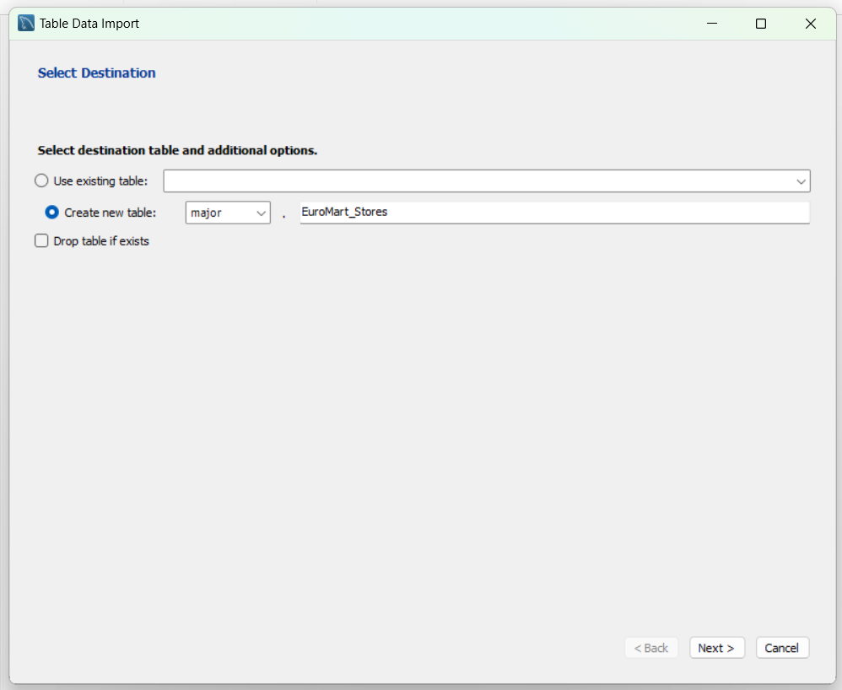
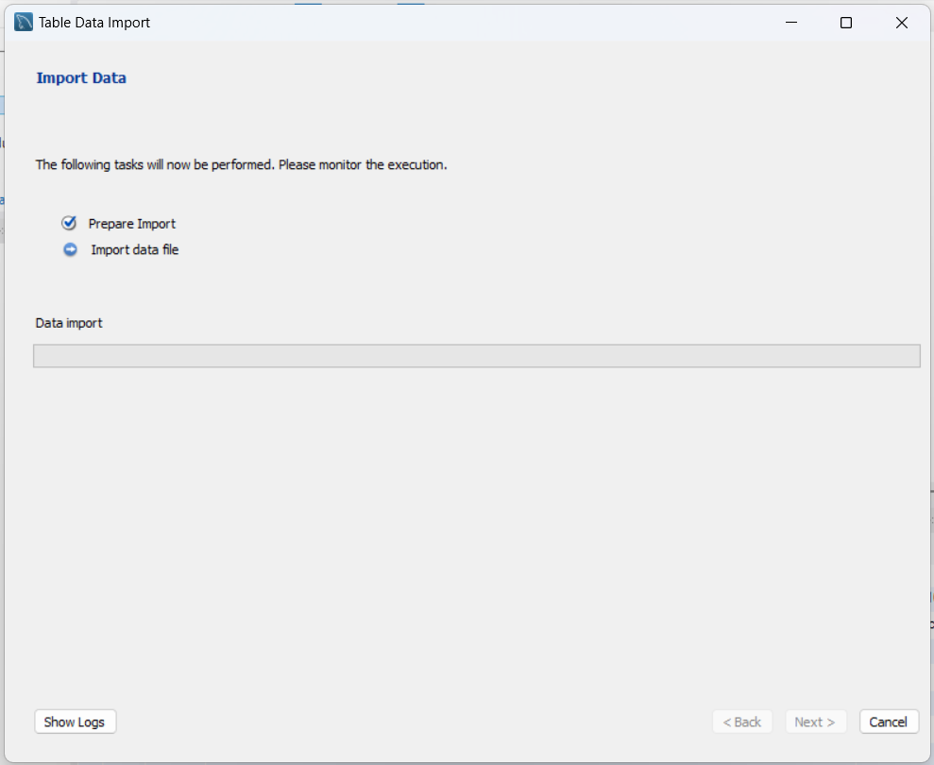
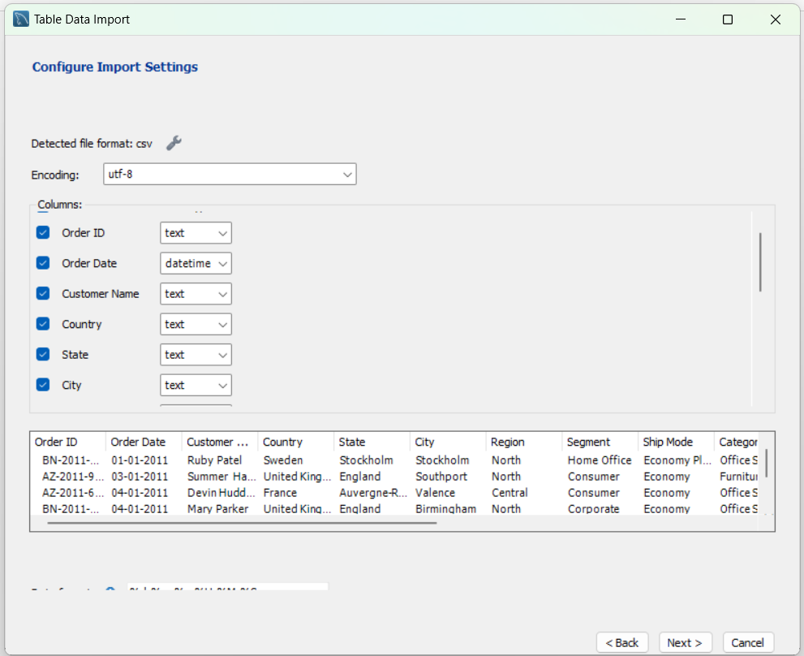
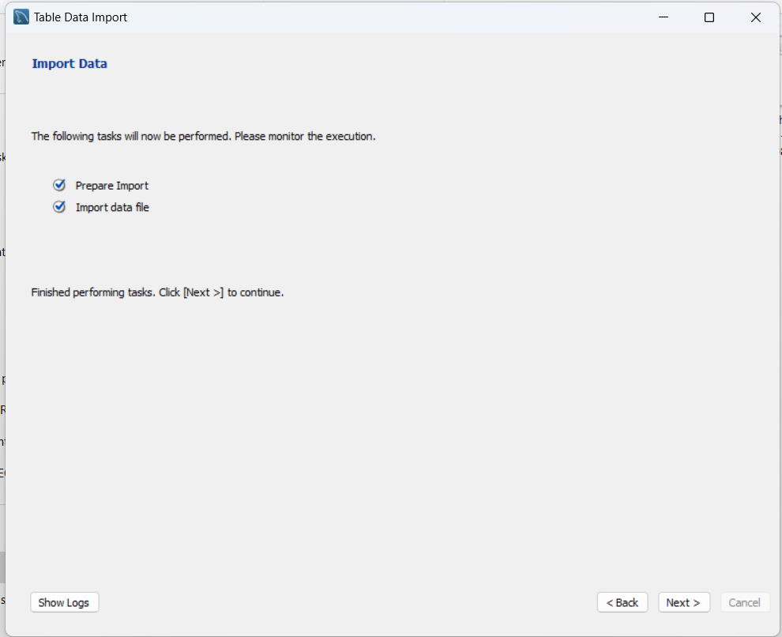
NOW THE DATA HAS BEEN IMPORTED
THE FURTHUR STEPS ARE

Slide 12

FOR MORE EFFECTIVE AND BREIF EXPLANATION
LETS MOVE TO VISUAL STUDIO
JUST CLICK ON THE ICON TO OPEN VISUAL STUDIO

